Slide 1
HYDERABAD INSTITUTE OF
TECHNOLOGY AND MANAGEMENT
IMPLEMENTATION OF CONVOLUTION NEURAL NETWORKS & FEED FORWARD NEURAL NETWORKS FOR COLOUR CLASSIFICATION AND REAL - TIME COLOUR PREDICTION FOR IMAGE PROCESSING
THE TEAM - (BATCH NO : A1)
G. Ramya
B. Prabhakar
G. Sanjana
K. Sai Ram
19E51A0423
19E51A0406
20E55A0407
20E55A0409
INTERNAL GUIDE : Dr. P. Rajesh Kumar
Principal and Professor
MAJOR PROJECT ACADEMIC YEAR : 2022-2023

Slide 2
LIST OF CONTENTS
EXPLANATION OF LAYERS
BLOCK DIAGRAM
CIRCUIT DIAGRAM
FEEDFORWARD NEURAL NETWORK IN MATLAB AND IN ENERGIA
ADVANTAGES
APPLICATIONS
REFERENCES
OBJECTIVE
MOTIVATION
LITERATURE SURVEY
INTRODUCTION
CONVOLUTION NEURAL NETWORKS
CNN LAYERS

Slide 3
OBJECTIVES
Implementing a custom Convolutional Neural Network (CNN) from scratch in MATLAB for color classification.
Utilizing the TCS3200 color sensor to detect and capture color information.
Developing a CNN-based model to accurately classify colors under ideal conditions.
Extending the CNN model to handle non-ideal conditions and variations in color detection.
Integrating a webcam to capture live images for real-time color prediction.
Transforming the MATLAB code into C code using Energia software for compatibility with the MSP430F5529LP microcontroller.
Establishing hardware connections between the MSP430F5529LP microcontroller, TCS3200 color sensor, and a 16x2 LCD display.
Displaying the predicted color and RGB values on the LCD display in real-time.
Evaluating and optimizing the performance of the CNN model for accurate color classification.
Demonstrating the effectiveness and practical applicability of the implemented CNN solution for color analysis.

Slide 4
MOTIVATION
Motivation: Classify colors and predict live colors using a webcam without relying on inbuilt functions in Matlab.
CNNs: Widely used in image and speech recognition, develop an internal representation of a two-dimensional image.
CNN Structure: Leverage the human visual cortex structure and employ convolutional layers.
Image Classification: Segment images based on features like edges, pixel intensity, and pixel value changes.
CNN Function: Assign importance to image aspects using learnable weights and biases.
Hardware: TCS3200 color sensor for color detection and webcam for live image capture.
Processing: CNN and FNN concepts used to process acquired images.
FNNs: Approximate functions depending on multiple inputs, applied in image and speech recognition.
Combined Approach: Enable accurate color classification and live color prediction with the webcam.
Inbuilt Functions: Project showcases the effectiveness of tailored CNN and FNN solutions without relying on Matlab's built-in functions.

Slide 5
LITERATURE SURVEY
The literature survey highlights the advancements in color classification using Convolutional Neural Networks (CNNs) [1]. Traditional methods like manual inspection and thresholding have limitations in handling complex color patterns and variations in lighting conditions [2]. CNNs have emerged as powerful tools for automatic feature extraction, leading to improved color classification accuracy [3]. Studies have shown the success of CNN-based color recognition systems, surpassing traditional methods. Transfer learning has been utilized to enhance performance, particularly when training data is limited [4]. Factors such as lighting conditions, image resolution, and color space representation impact color classification, and researchers have proposed strategies to mitigate these effects [5]. Real-time color analysis using CNNs in video streams has also been explored[6]. Overall, CNNs offer superior performance and real-time capabilities for color classification, contributing to advancements in this field.

Slide 6
INTRODUCTION
This project focuses on implementing a custom CNN for real-time color classification and prediction using a webcam. Traditional color classification methods may struggle with complex color distributions, so deep learning techniques, particularly CNNs, are employed. The TCS3200 color sensor detects colors, and a webcam captures live images. The implemented CNN, developed in MATLAB, extracts and assigns significance to image features for accurate color classification. The Keras library is used for implementing a multi-input CNN model. The Energia software platform enables practical implementation on the MSP430F5529LP microcontroller, with hardware components like the LCD display for real-time color analysis. The project showcases the effectiveness of the custom CNN approach for accurate color classification in various conditions.

Slide 7
CNN LAYERS
Convolutional Layer: This layer performs the convolution operation by applying a set of filters or kernels to the input image or feature maps. It extracts features and reduces the spatial dimensions of the input.
Pooling Layer: This layer performs pooling operations such as max pooling or average pooling to down sample the output of the convolutional layer. It reduces the spatial dimensions of the input while preserving the important features.
Fully Connected Layer: This layer connects all neurons in the previous layer to all neurons in the next layer, and performs a linear transformation followed by a non-linear activation function.
Dropout Layer: This layer randomly drops out a proportion of the inputs to the next layer during training to prevent overfitting.
Batch Normalization Layer: This layer normalizes the input to each layer, improving the stability of the network during training.
Activation Layer: This layer applies a non-linear activation function to the output of the previous layer.
Softmax Layer: This layer is typically used as the output layer for classification problems. It computes the probabilities of each class and outputs the class with the highest probability.

Slide 8
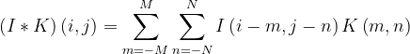
CONVOLUTION LAYER
The Convolution layer is the core component of a CNN. It performs a convolution operation on the input data using a set of learnable filters or kernels. The output of a convolution layer is a set of feature maps that represent different aspects of the input data.
The convolution operation can be expressed mathematically as follows:
where,
I is the input data of size H x W x C,
K is the convolution kernel of size M x N x C,
denotes the convolution operation,
i and j are the spatial coordinates of the output feature map, and
H, W, C are the height, width, and number of channels of the input data, respectively.

Slide 9
POOLING LAYER
The Pooling layer is used to down sample the feature maps produced by the convolutional layer. Max pooling is the most commonly used pooling operation, which selects the maximum value in a given window of the feature map. The output of a pooling layer is a set of down sampled feature maps.
The max pooling operation can be expressed mathematically as follows:
where,
I is the input feature map of size H x W x C, O is the output feature map of size H/K x W/L x C, K and L are the size of the pooling window in the spatial dimensions, m and n are the spatial coordinates of the pooling window, c is the channel index, and the max operation selects the maximum value in the pooling window.

Slide 10
ACTIVATION LAYER
The Activation function is applied element-wise to the output of a convolutional or pooling layer to introduce non-linearity into the model. The most commonly used activation functions are ReLU (Rectified Linear Unit) and its variants.
The ReLU function can be expressed mathematically as follows:
where,
x is the input to the activation function, and the max operation sets all negative values to zero.
In summary, the formulas used in CNN layers are:
Convolution layer:
Pooling layer:
Activation function (ReLU):

Slide 11
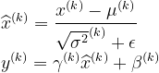
BATCH NORMALIZATION LAYER
Batch Normalization (BN) is a technique used to normalize the inputs of a layer by subtracting the mean and dividing by the standard deviation. This helps to reduce the internal covariate shift, which is the phenomenon of the distribution of layer inputs changing during training.
The formula for Batch Normalization is as follows:
where,
x^(k) is the input to the k-th layer, mu^(k) and sigma^2^(k) are the mean and variance of the k-th layer, epsilon is a small constant to avoid division by zero, gamma^(k) and beta^(k) are the scale and shift parameters of the k-th layer that are learned during training, and y^(k) is the output of the k-th layer.

Slide 12
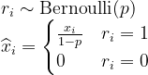
DROPOUT LAYER
Dropout is a regularization technique used to prevent overfitting by randomly setting some of the activations in a layer to zero during training. This forces the network to learn more robust features and reduces the reliance on any one feature.
The formula for Dropout is as follows:
where,
p is the probability of setting a neuron to zero, r_i is a random variable drawn from a Bernoulli distribution with probability p, x_i is the input to the neuron, and y_i is the output of the neuron after applying the Dropout operation.

Slide 13
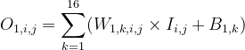
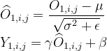
Example Of A CNN Architecture For Facial Expression Recognition
Input: The input is a grayscale image of size 48x48 pixels.
Convolution Layer 1: The first convolution layer applies 16 filters of size 3x3 to the input image. The output of this layer is calculated as follows:
where O is the output feature map, W is the filter weights, I is the input image, and B is the bias term. The ReLU activation function is then applied to the output.
Batch Normalization: The activations in the convolution layer are normalized using batch normalization. The normalized activations are calculated as follows:
where μ and σ are the mean and standard deviation of the activations across the mini-batch, γ and β are learnable scaling and shifting parameters, and ϵ is a small constant to prevent division by zero.

Slide 14
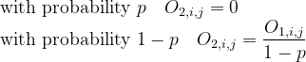
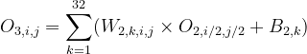
4. Max Pooling: The output of the first convolution layer is passed through a max pooling layer with a pooling size of 2x2, which down samples the feature maps by selecting the maximum activation within each pooling window.
5. Dropout: A dropout layer with a dropout probability of p is applied to the output of the first max pooling layer. The output of the dropout layer is calculated as follows:
The formula for the dropout layer output continues as follows:
where O is the output of the first max pooling layer and O2 is the output of the dropout layer.
Convolution Layer 2: The second convolution layer applies 32 filters of size 3x3 to the output of the dropout layer. The output of this layer is calculated as follows:

Slide 15
where, O2 is the output of the dropout layer, W2 is the filter weights, and B2 is the bias term. The ReLU activation function is then applied to the output.
Batch Normalization: The activations in the second convolution layer are normalized using batch normalization, as described previously.
Max Pooling: The output of the second convolution layer is passed through a max pooling layer with a pooling size of 2x2, which down samples the feature maps.
Flatten: The output of the second max pooling layer is flattened into a 1D vector, which is then passed through a fully connected layer.
Fully Connected Layer: The flattened output is passed through a fully connected layer with 128 units, followed by a ReLU activation function.
Dropout: A dropout layer with a dropout probability of p is applied to the output of the fully connected layer.

Slide 16
Output Layer: The output layer is a fully connected layer with 7 units, corresponding to the 7 possible facial expressions (angry, disgust, fear, happy, sad, surprise, and neutral). The soft max activation function is applied to the output of this layer to obtain the probability distribution over the classes.
The entire architecture is trained using backpropagation and stochastic gradient descent to minimize the cross-entropy loss between the predicted and true labels.

Slide 17
FEED FORWARD NEURAL NETWORK
A feedforward neural network (FFNN) is a type of artificial neural network that consists of an input layer, one or more hidden layers, and an output layer. The layers are connected in a feedforward manner, meaning that the output of one layer serves as the input for the next layer.
The input layer is responsible for receiving the input data, which is then passed through the hidden layers to the output layer. The output layer produces the final output of the network.
Each neuron in the hidden layers and the output layer is associated with a weight, which determines the strength of its connection to other neurons in the network. These weights are adjusted during the training process to improve the performance of the network.
FFNNs are commonly used for classification and regression tasks. In a classification task, the output of the network represents the probability of a given input belonging to each class. In a regression task, the output represents a continuous value.
FFNNs use an activation function to introduce non-linearity into the network. Common activation functions include sigmoid, tanh, and ReLU.
The training process of an FFNN involves forward propagation, which involves passing the input data through the network and calculating the output, and backward propagation, which involves adjusting the weights of the neurons in the network based on the error between the predicted output and the actual output.
FFNNs have been successful in a wide range of applications, including image recognition, speech recognition, and natural language processing.

Slide 18
COLOR CLASSIFICATION USING FFNS
Feed forward neural networks (MLPs) are used for color classification and detection tasks.
MLPs consist of layers of neurons with non-linear activation functions.
Preprocessing is done to extract color information from input data.
Input data is converted to color space and color channels are extracted.
Each neuron in the first layer represents a specific color channel.
The network is trained using a labeled dataset.
Weights and biases of neurons are adjusted through optimization during training.
Trained network can classify new color samples.
Input data is fed into the network, and the output represents the predicted color class.
Predicted color class is compared to the actual color class for evaluation.

Slide 19
PROJECT - 1

Slide 20
SOURCE CODE - 1 (Implemented in MATLAB)
function CC()%
Define the training inputs and outputs
inputs = [0 0 0; 0 0 1; 0 1 0; 0 1 1; 1 0 0; 1 0 1; 1 1 0; 1 1 1];
outputs = [1 1 1 2 2 2 2 2];
% Initialize the weights and biases
randomlyhidden_weights = rand(4, 3);
hidden_bias = rand(1, 4);
output_weights = rand(4, 4)’;
output_bias = rand(1, 1);
% Set the learning rate and number of epochs
learning_rate = 0.1;num_epochs = 10000;
% Define the sigmoid
functionsigmoid = @(x) 1./(1+exp(-x));
% Train the network for epoch
epoch= 1:num_epochs
% Forward pass
hidden_inputs = hidden_weights * inputs';
hidden_outputs = sigmoid(hidden_inputs)';
output_inputs = (output_weights)' * (hidden_outputs)' + (output_bias);
output = sigmoid(output_inputs);
% Calculate the error
error = outputs - output;
% Backward pass
output_delta = error.* sigmoid_derivative(output_inputs);
hidden_delta = (output_weights * output_delta)' .* sigmoid_derivative(hidden_inputs)';
% Update the weights and biases
output_weights = output_weights + learning_rate .* (output_delta * hidden_outputs)';
output_bias = output_bias + learning_rate .* output_delta;
hidden_weights = hidden_weights + learning_rate .* (hidden_delta' * inputs);
hidden_bias = hidden_bias + learning_rate .* hidden_delta;
end
% Test the network on a new input
test_input = [0.5 0.5 1];
hidden_output = sigmoid(hidden_weights * test_input' + hidden_bias’);
test_output = sigmoid(output_weights' * hidden_output + output_bias);
% Print the output
if test_output < 0.5
disp('This color is classified as class 1’);
else
disp('This color is classified as class 2’);
End
% Define the sigmoid derivative function
function y = sigmoid_derivative(x);
y = sigmoid(x) .* (1 - sigmoid(x));
end

Slide 21
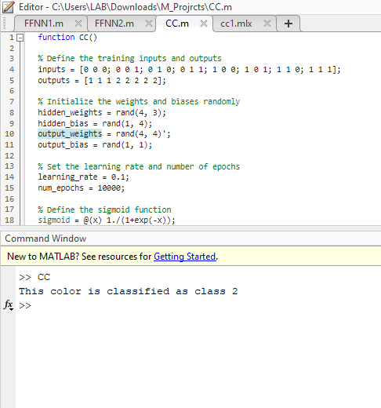
EXECUTION RESULTS
Fig 1: Classifying the colours using two classes

Slide 22
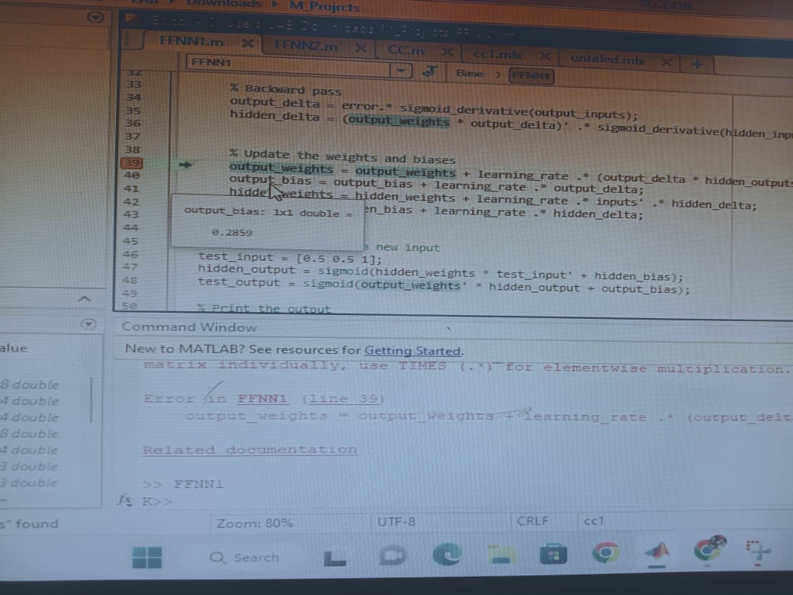
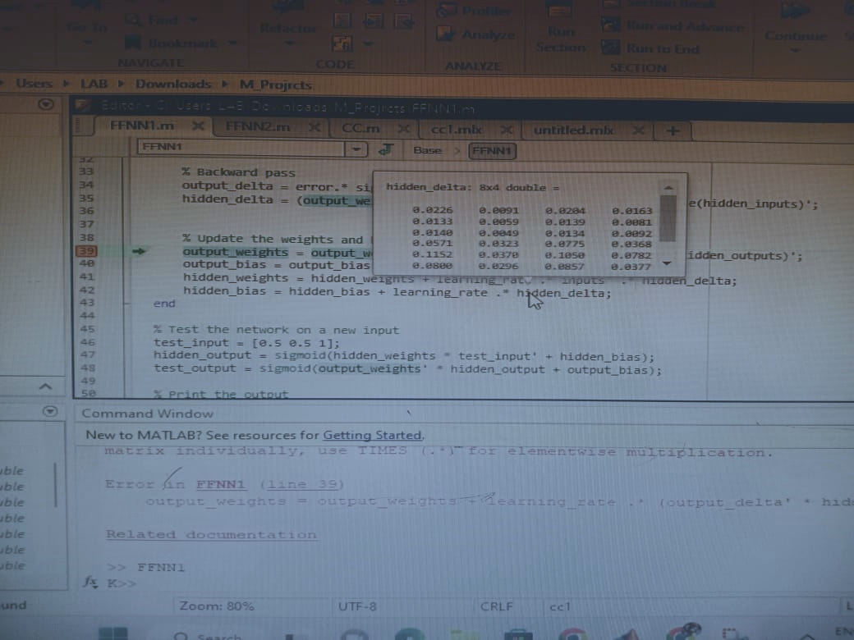
RESULTS AND ANALYSIS
Fig 2: Output bias value
Fig 3: Hidden delta values from 0 to 1

Slide 23
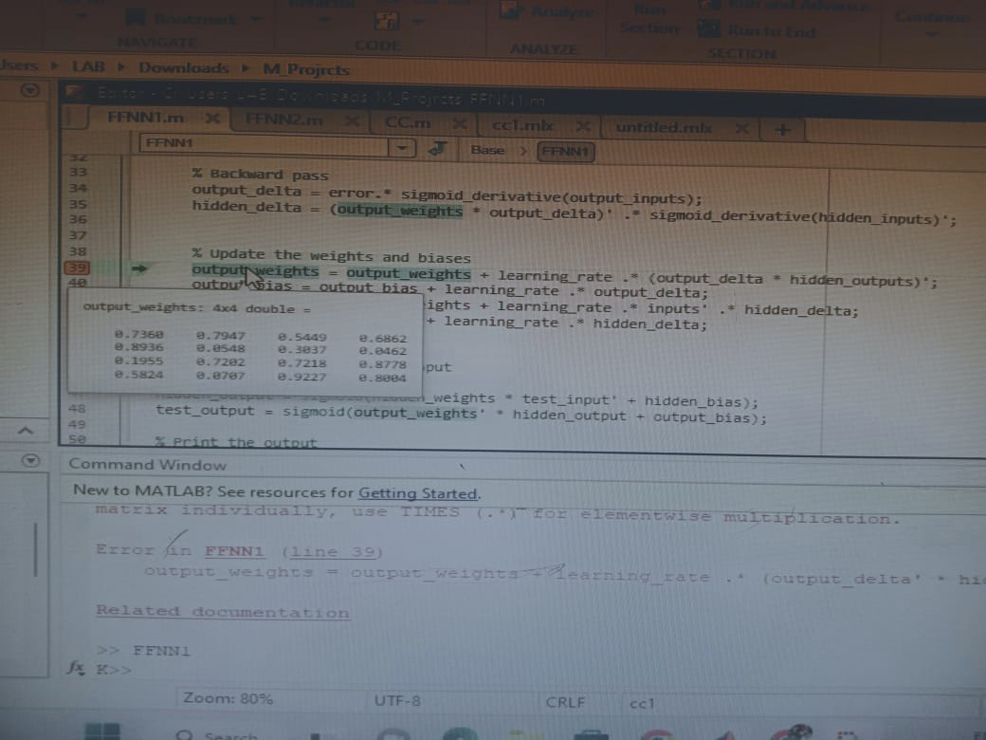
RESULTS AND ANALYSIS
Fig 4: Hidden delta values from 0 to 1
Fig 5: Output weights from 0 to 1

Slide 24
DEVELOPMENT OF PROJECT - 1
PROJECT - 2

Slide 25
SOURCE CODE - 2 (Implemented in MATLAB) PREDICTION OF COLORS IN MATLAB
% Live Color Detection without inbuilt functions
clear all; close all; clc;
% Define the color palette
red = [255 0 0];
green = [0 255 0];
blue = [0 0 255];
yellow = [255 255 0];
purple = [255 0 255];
cyan = [0 255 255];
magenta = [255 0 255];
white = [255 255 255];
black = [0 0 0];
dark_red = [139 0 0];
dark_green = [0 100 0];
dark_blue = [0 0 139];
brown = [165 42 42];
orange = [255 165 0];
pink = [255 192 203];
colors = {red, green, blue, yellow, purple, cyan, magenta, white, black, dark_red, dark_green, dark_blue, brown, orange, pink};
% Create a webcam object and preview the video feed
cam = webcam(1);
preview(cam);
% Loop to continuously capture and process frames
while true
% Capture a frame and convert it to grayscale
img = snapshot(cam);
img_gray = rgb2gray(img);
% Threshold the grayscale image to create a binary mask
threshold = graythresh(img_gray);
img_bw = imbinarize(img_gray, threshold);
% Remove small noise regions from the binary mask
img_bw = bwareaopen(img_bw, 1000);
% Label the connected regions in the binary mask
[labelled_img, num_regions] = bwlabel(img_bw);
% Find the region with the largest area
max_area = 0;
max_region_idx = 0;
for i = 1:num_regions
region = (labelled_img == i);
region_area = sum(region(:));
if region_area > max_area
max_area = region_area;
max_region_idx = i;
end
end
% Extract the RGB color of the largest region
region = (labelled_img == max_region_idx);
[row, col] = find(region);
R = 0;
G = 0;
B = 0;
for i = 1:length(row)
R = R + double(img(row(i), col(i), 1));
G = G + double(img(row(i), col(i), 2));
B = B + double(img(row(i), col(i), 3));
end
color = [R/length(row), G/length(row), B/length(row)];
% Classify the color based on the predefined color palette
min_dist = inf;
color_name = '';
for i = 1:length(colors)
dist = sum((colors{i} - color).^2);
if dist < min_dist
min_dist = dist;
color_name = colors{i};
end
end
if isequal(color_name, red)
color_name = 'Red';
elseif isequal(color_name, green)
color_name = 'Green';
elseif isequal(color_name, blue)
color_name = 'Blue';
elseif isequal(color_name, yellow)
color_name = 'Yellow';
elseif isequal(color_name, purple)
color_name = 'Purple';
elseif isequal(color_name, black)
color_name = 'black';
elseif isequal(color_name, cyan)
color_name = 'cyan';
elseif isequal(color_name, magenta)
color_name = 'magenta';
elseif isequal(color_name, white)
color_name = 'white';
elseif isequal(color_name, dark_red)
color_name = 'dark_red';
elseif isequal(color_name, dark_green)
color_name = 'dark_green';
elseif isequal(color_name, dark_blue)
color_name = 'dark_blue';
elseif isequal(color_name, brown)
color_name = 'brown';
elseif isequal(color_name, orange)
color_name = 'orange';
elseif isequal(color_name, pink)
color_name = 'pink';
end
% Display the original image with the color name
img = insertText(img, [10, 10], color_name, 'FontSize', 30, 'BoxColor', 'white', 'BoxOpacity', 0.5);
imshow(img);
end

Slide 26
DEVELOPMENT OF PROJECT - 2
WITH HARDWARE &
REQUIRED SOFTWARE TOOL

Slide 27
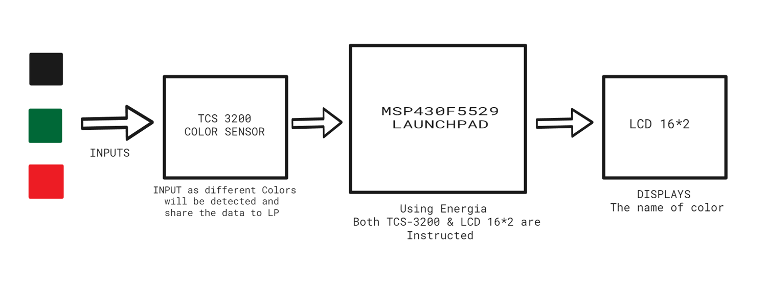
BLOCK DIAGRAM

Slide 28
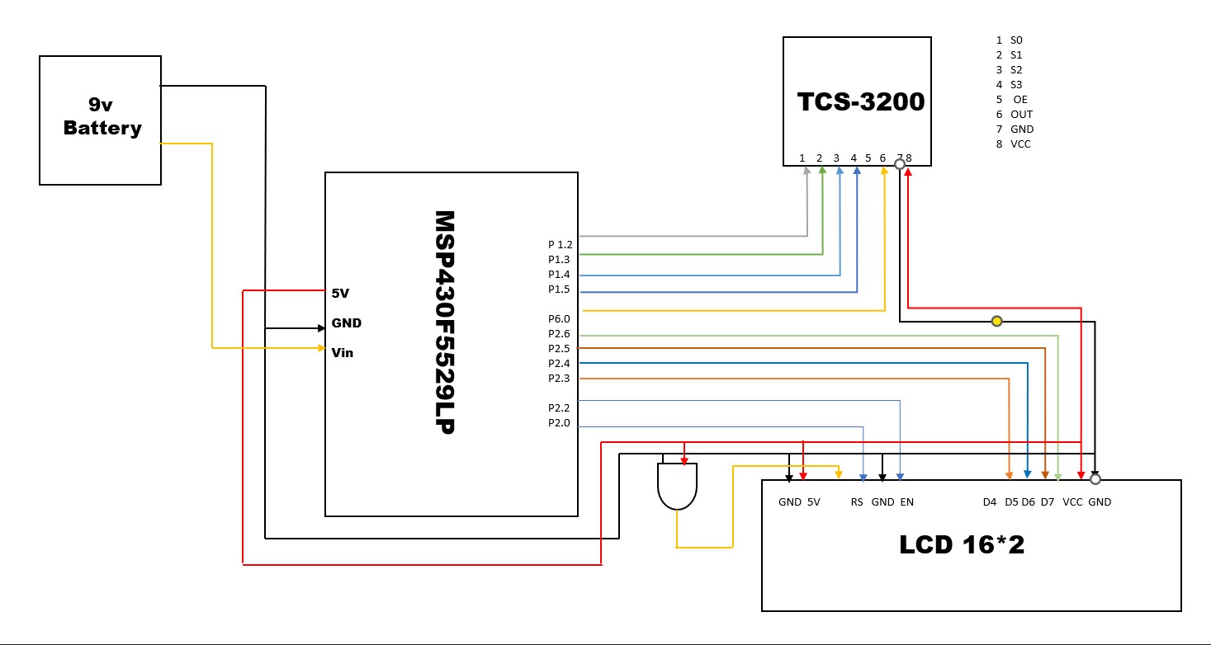
CIRCUIT DIAGRAM

Slide 29
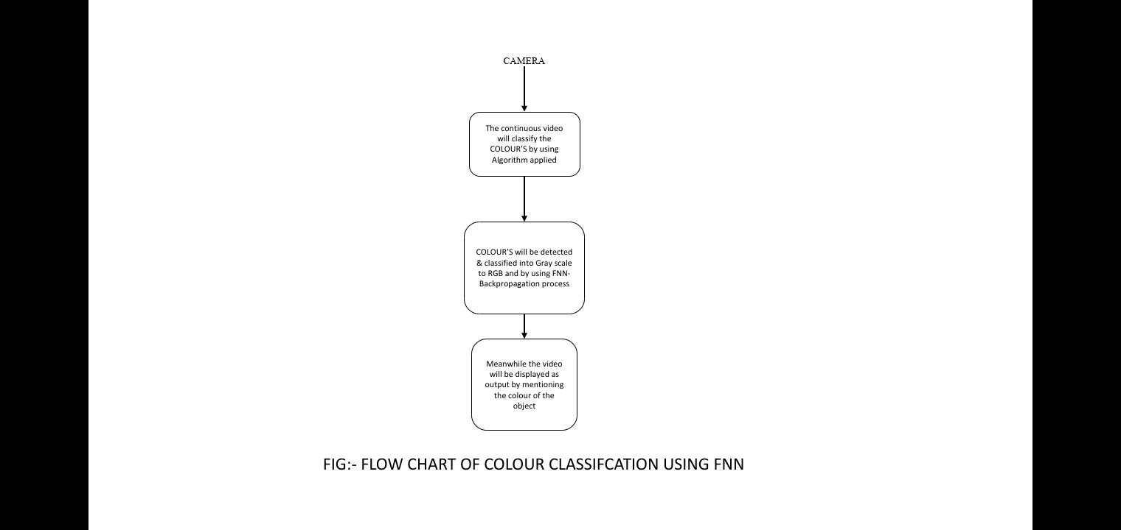
FLOW CHART - 1

Slide 30
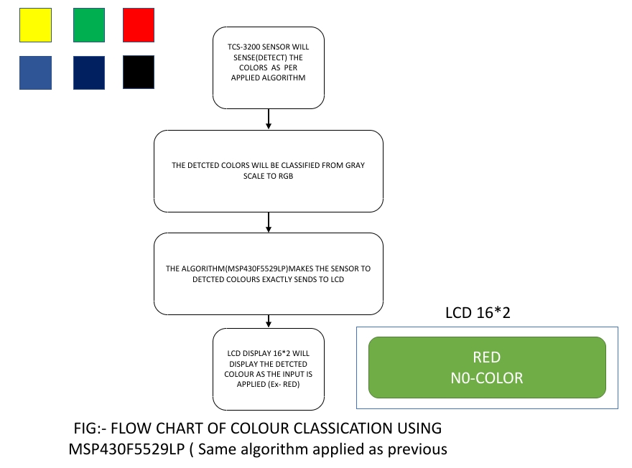
FLOW CHART - 2
)

Slide 31
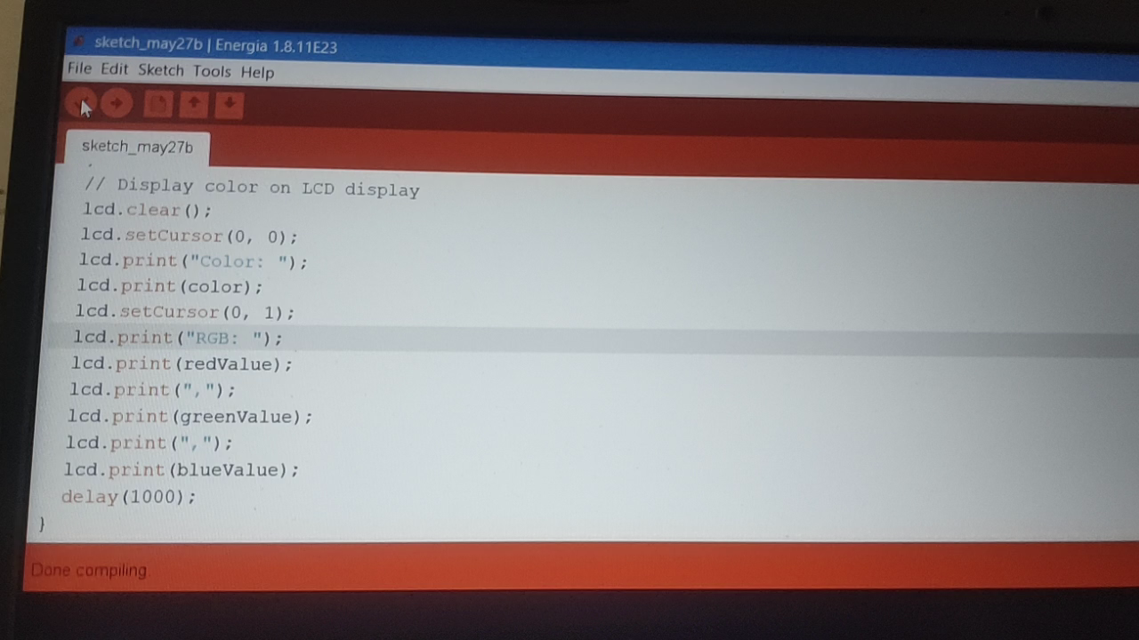
EXECUTION RESULTS
LIVE CAPTURE OF COLOURS USING A WEBCAM IN MATLAB

Slide 32
SOURCE CODE - 3 (Implemented in ENERGIA) PREDICTION OF COLORS IN MATLAB
#include <Energia.h>
#include <LiquidCrystal.h>
// Define pins for TCS3200 color sensor
#define S0 P1_2
#define S1 P1_3
#define S2 P1_4
#define S3 P1_5
#define OUT P6_0
// Define pins for LCD display
#define RS P2_0
#define EN P2_2
#define D4 P2_3
#define D5 P2_4
#define D6 P2_5
#define D7 P2_6
// Define LCD display object
LiquidCrystal lcd(RS, EN, D4, D5, D6, D7);
void setup() {
// Set control pins as outputs
pinMode(S0, OUTPUT);
pinMode(S1, OUTPUT);
pinMode(S2, OUTPUT);
pinMode(S3, OUTPUT);
// Set sensor output as input
pinMode(OUT, INPUT);
// Set frequency-scaling to 20%
digitalWrite(S0, HIGH);
digitalWrite(S1, LOW);
// Initialize LCD display
lcd.begin(16, 2);
}
void loop() {
// Read frequency of red color
digitalWritee(S2, LOW);
digitalWrite(S3, LOW);
int redFrequency = pulseIn(OUT, LOW);
// Read frequency of green color
digitalWrite(S2, HIGH);
digitalWrite(S3, HIGH);
int greenFrequency = pulseIn(OUT, LOW);
// Read frequency of blue color
digitalWrite(S2, LOW);
digitalWrite(S3, HIGH);
int blueFrequency = pulseIn(OUT, LOW);
// Calculate RGB values of color
int redValue = map(redFrequency, 0, 1000, 0, 255);
int greenValue = map(greenFrequency, 0, 1000, 0, 255);
int blueValue = map(blueFrequency, 0, 1000, 0, 255);
// Predict color based on RGB values
String color;
if (redValue > greenValue && redValue > blueValue) {
color = "Red";
} else if (greenValue > redValue && greenValue > blueValue) {
color = "Green";
} else if (blueValue > redValue && blueValue > greenValue) {
color = "Blue";
} else if (redValue == greenValue && redValue == blueValue) {
color = "White";
} else {
color = "Unknown";
}
// Display color on LCD display
lcd.clear();
lcd.setCursor(0, 0);
lcd.print("Color: ");
lcd.print(color);
lcd.setCursor(0, 1);
lcd.print("RGB: ");
lcd.print(redValue);
lcd.print(",");
lcd.print(greenValue);
lcd.print(",");
lcd.print(blueValue);
delay(1000);
}

Slide 33
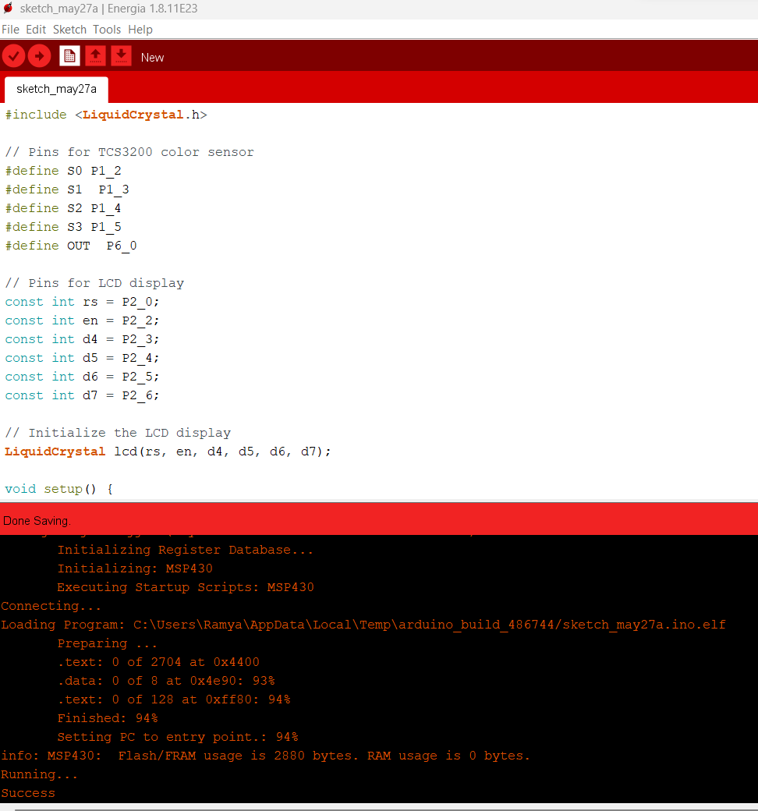
Fig 2: Verified Code in ENERGIA Software

Slide 34
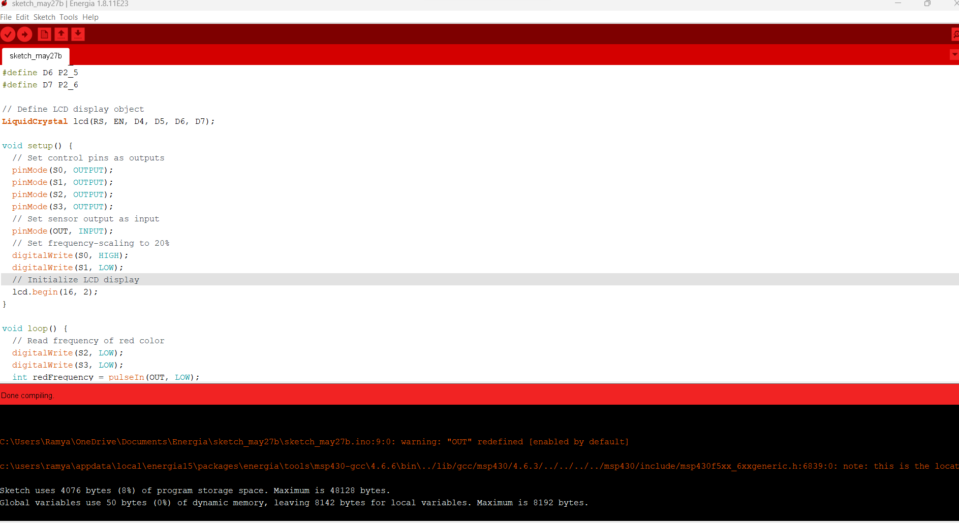
SOFTWARE EXECUTION RESULTS
Fig 3: Compiled Code in ENERGIA Software

Slide 35
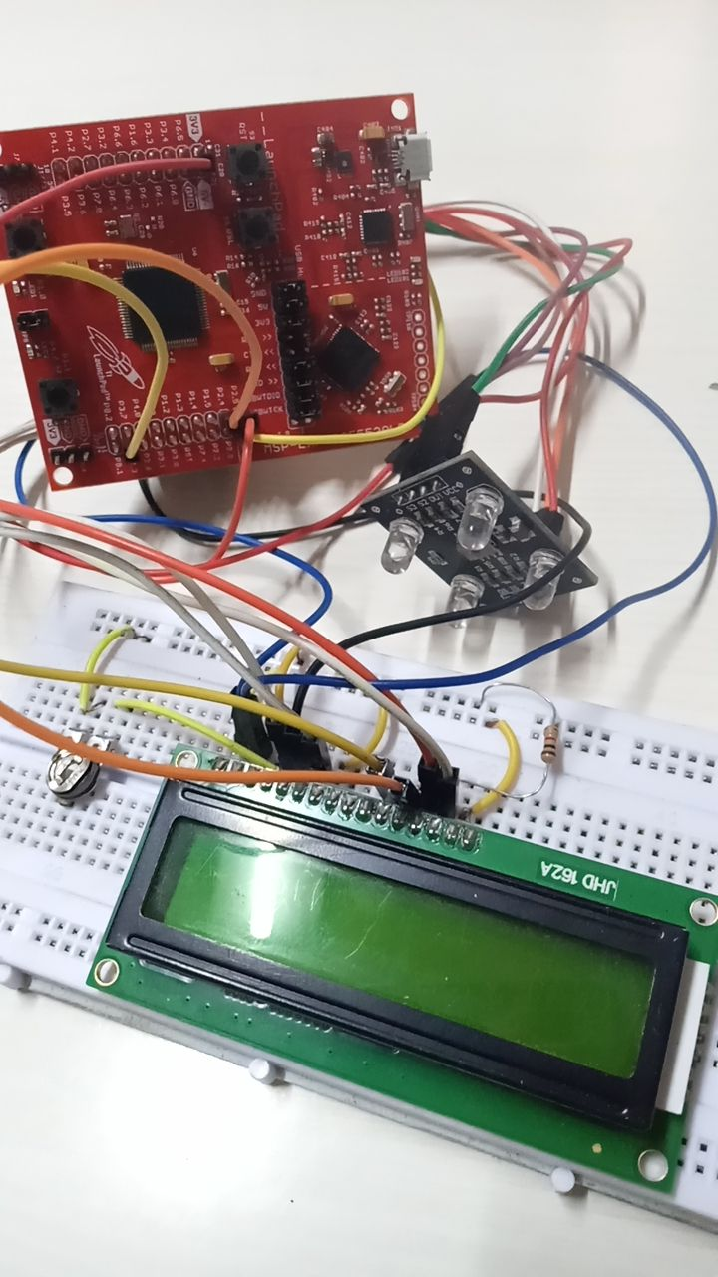
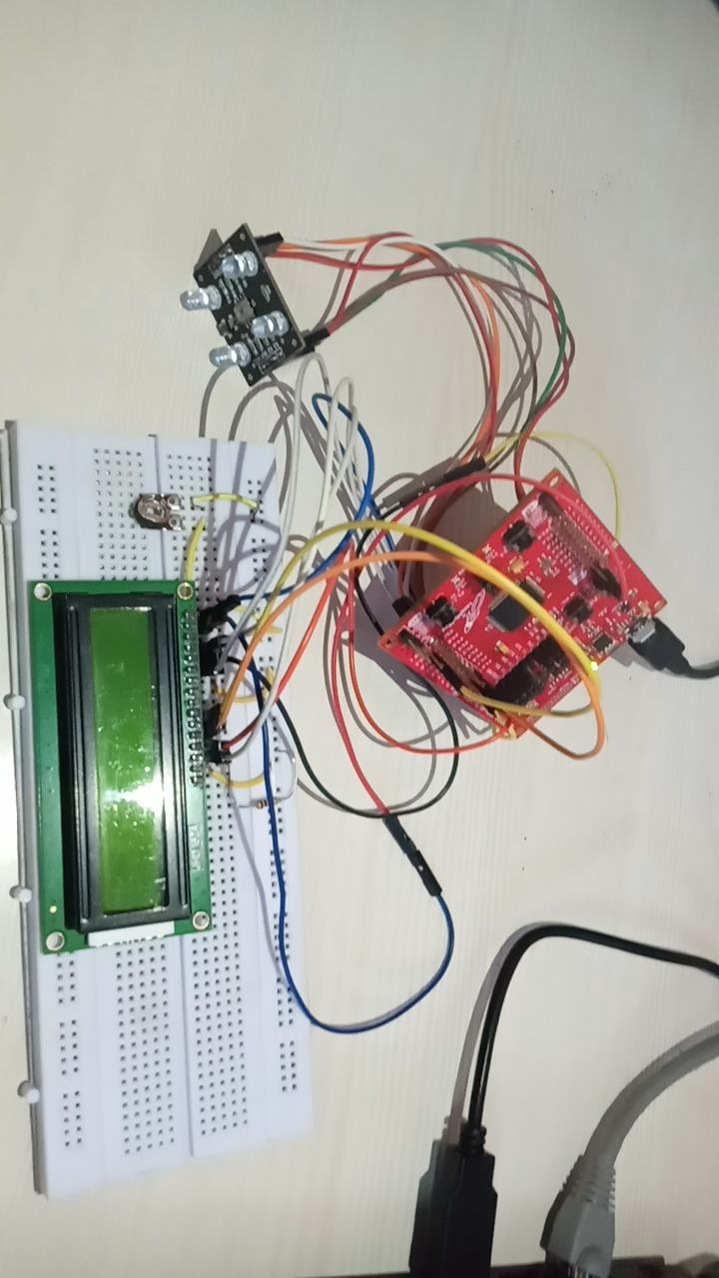
HARDWARE EXECUTION RESULTS

Slide 36
ADVANTAGES OF CNN - KNN
Neural networks can learn complex patterns and relationships in data, making them suitable for color classification tasks.
They can handle non-linear relationships between color features, allowing for accurate classification.
Neural networks can adapt and generalize well to different color distributions and lighting conditions.
They can be trained on large datasets, improving their performance and robustness.
Neural networks can process images in real-time, enabling live color prediction using a webcam.

Slide 37
APPLICATIONS
Object recognition: Neural networks can be used to classify colors of objects in images or videos, enabling object recognition and tracking systems.
Quality control: Neural networks can assist in color-based quality control processes, such as identifying defective or mismatched products based on color characteristics.
Sorting and categorization: Neural networks can be utilized in color-based sorting systems, where objects or materials are classified and sorted based on their color attributes.
Image processing: Neural networks can enhance color-based image processing tasks, such as color correction, image segmentation, and image retrieval.
Industrial automation: Neural networks can be integrated into industrial automation systems to classify and analyze colors in real-time, facilitating automated decision-making processes.
Robotics: Neural networks can support color perception in robotic systems, enabling robots to interact with and respond to color-coded objects or environments.
Biomedical imaging: Neural networks can aid in color-based analysis and interpretation of medical images, assisting in areas such as tissue segmentation and disease diagnosis.
Gaming and augmented reality: Neural networks can be used to recognize and track colors in gaming and augmented reality applications, enabling interactive and immersive experiences.
Traffic monitoring: Neural networks can analyze color information from traffic surveillance cameras to detect and track vehicles, monitor traffic flow, and identify violations.

Slide 38
REFERENCES
[1]. Wang, Y., Ma, Z., Li, G., & Yuan, Y. (2015). Color image classification using local color features and SVM. Signal Processing, 111, 49-59.
[2]. "A CNN-Based Real-Time Facial Expression Recognition System on Raspberry Pi" by S. Kumari and V. Tyagi in the International Journal of Advanced Trends in Computer Science and Engineering, Volume 8 - Issue 3, May-June 2019.
[3]. "Liu, T., Liu, Y., Wu, F., & Chen, J. (2018). An efficient color-based image retrieval system using color and texture features. Multimedia Tools and Applications, 77(6), 6947-6966.
[4]. "Basso, L., Diaz, M., & Veloso, M. (2016). Learning color categories for object detection. In Proceedings of the IEEE/RSJ International Conference on Intelligent Robots and Systems (IROS) (pp. 4057-4062).
[5]. "Jin, X., Ma, Z., Huang, M., & Chen, S. (2017). Review on color image segmentation methods. Pattern Recognition, 63, 155-171.
[6]. "Sun, H., Jin, L., Liu, Z., & Lin, Y. (2015). Color image enhancement based on local adaptive color correction. Signal Processing, 107, 430-441.

Slide 39
THANK YOU

